Slide 1
NLP-Word Embedding
by Hassan Badawy

Slide 2
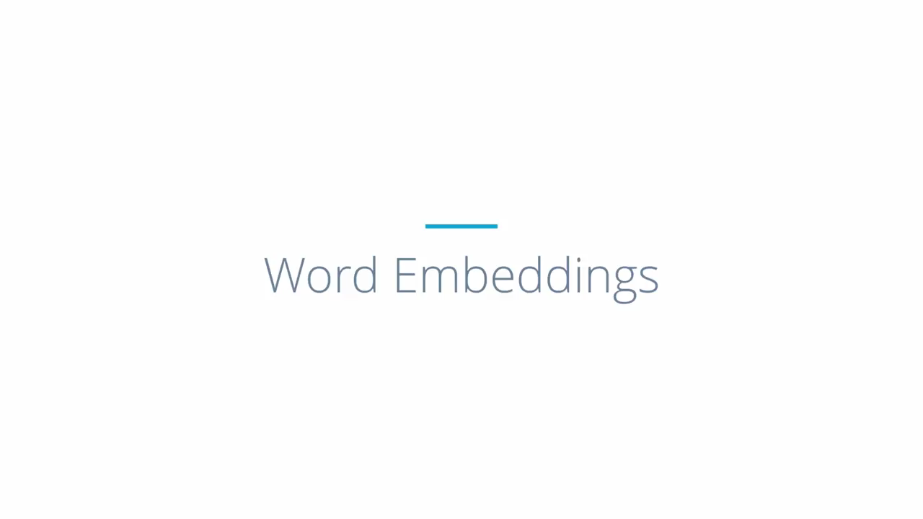

Slide 3
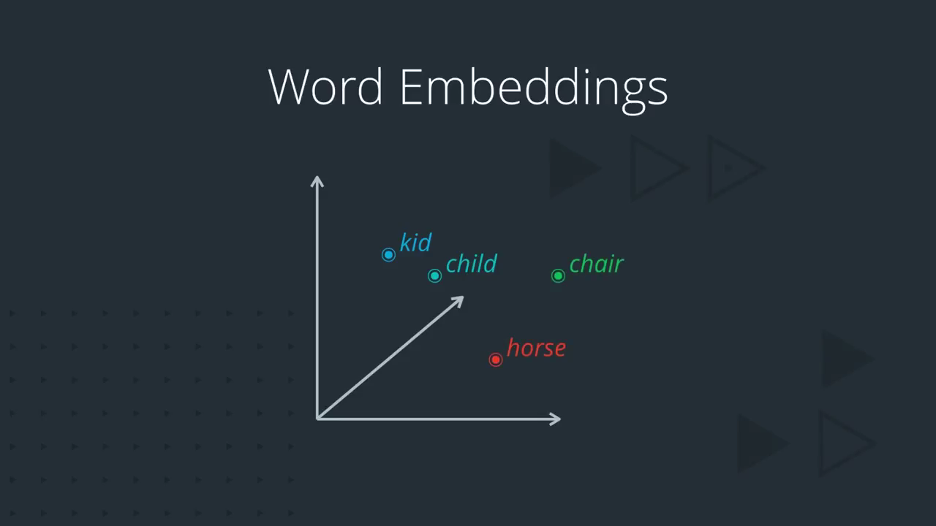

Slide 4
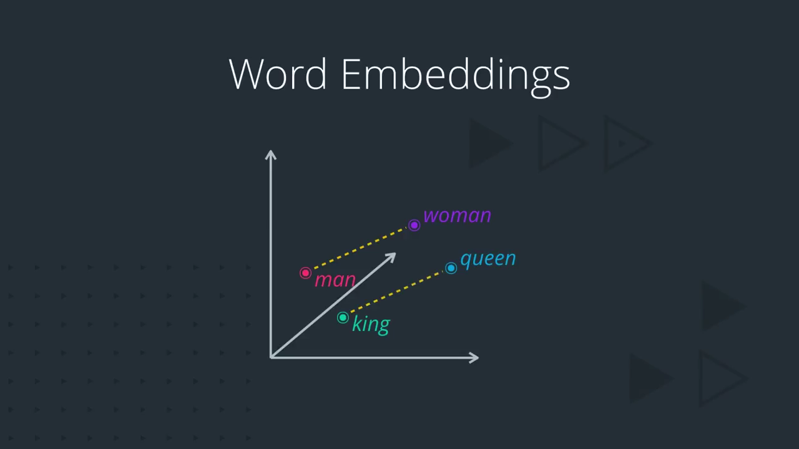

Slide 5
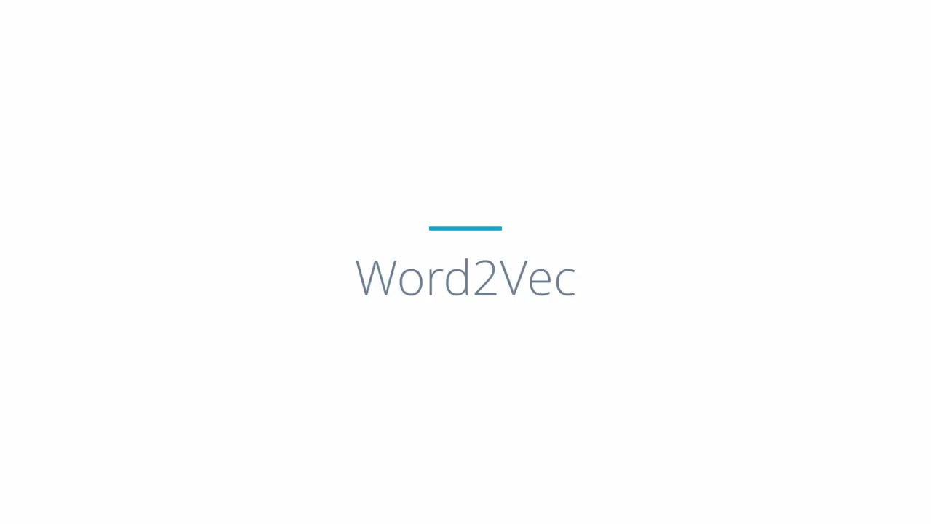
Prediction based Models

Slide 6
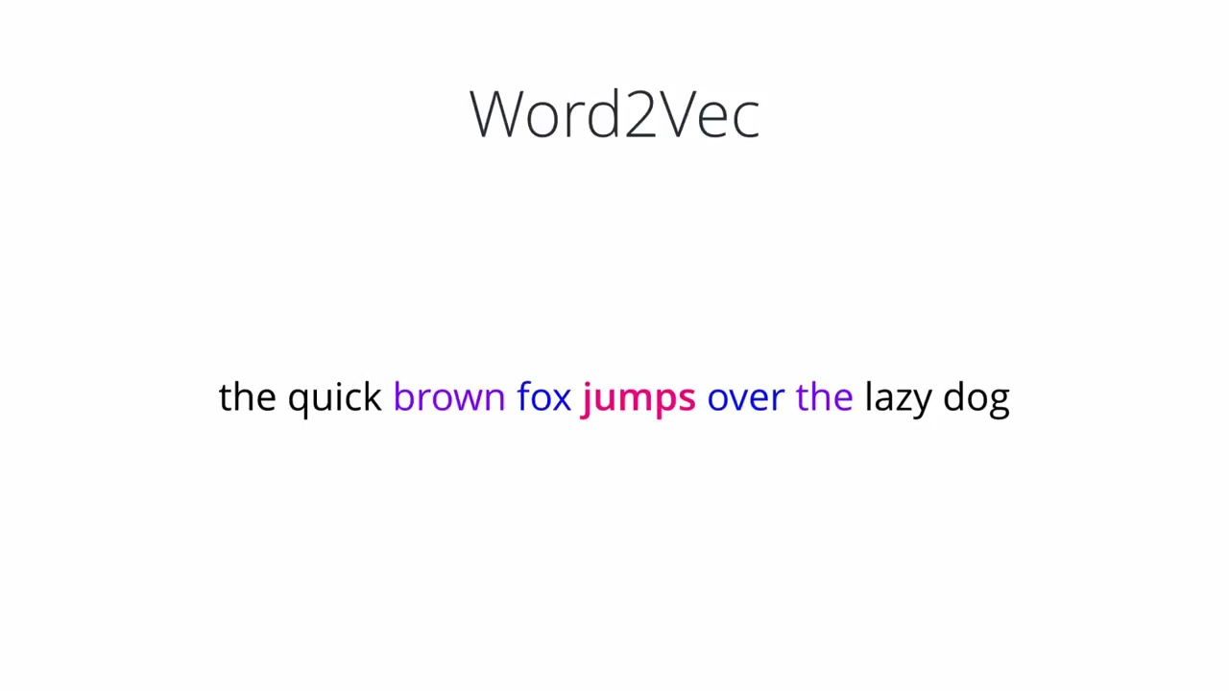
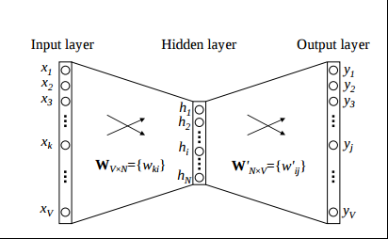

Slide 7
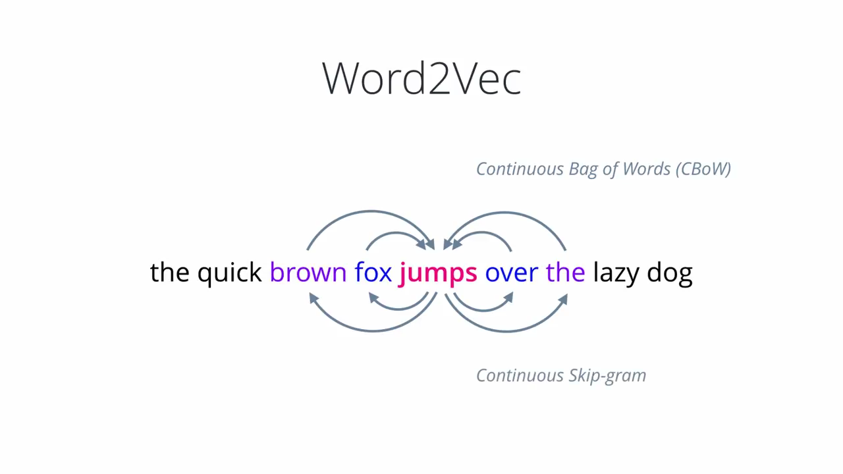
Word2vec is not a single algorithm but a combination of two techniques – CBOW(Continuous bag of words) and Skip-gram model.

Slide 8
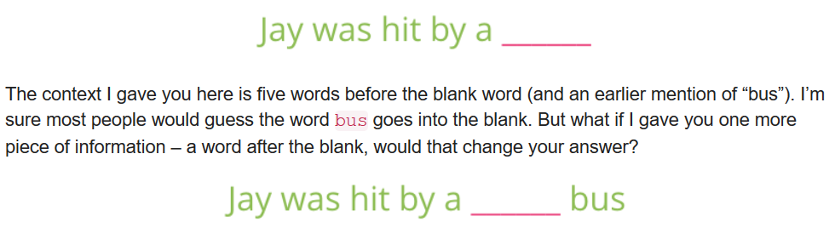
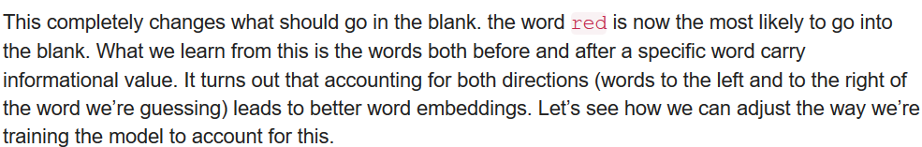
CBOW(Continuous bag of words)

Slide 9
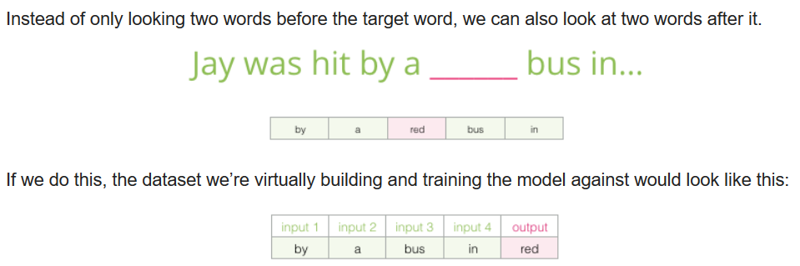
CBOW(Continuous bag of words)

Slide 10
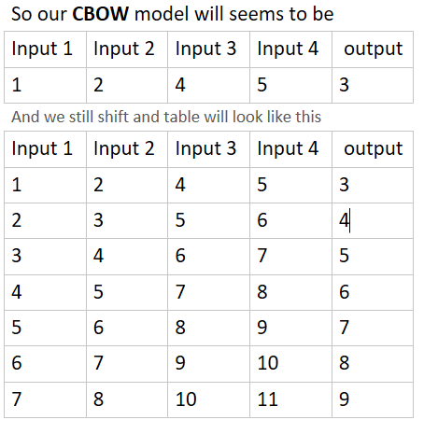
CBOW(Continuous bag of words)
So CBOW Looks like, if we need our model to learn counting
1, 2, _, 4, 5
You will say ok, it is very easy it will be 3, but that for human brain that trained
From the childhood to memoriz number series, but for our model is still a baby :)

Slide 11
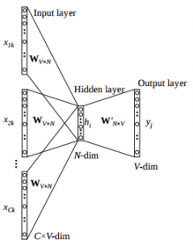
CBOW(Continuous bag of words)

Slide 12

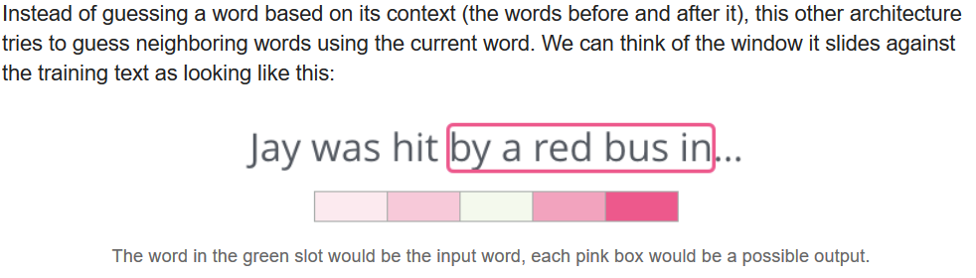
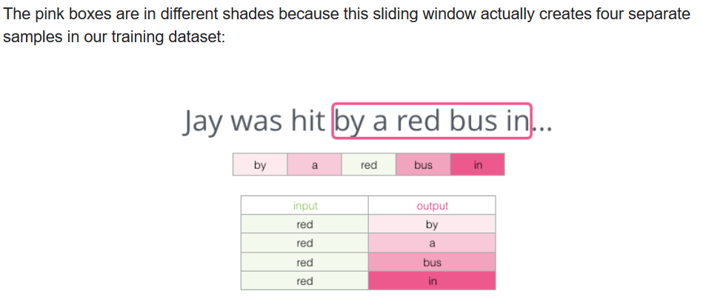

Slide 13
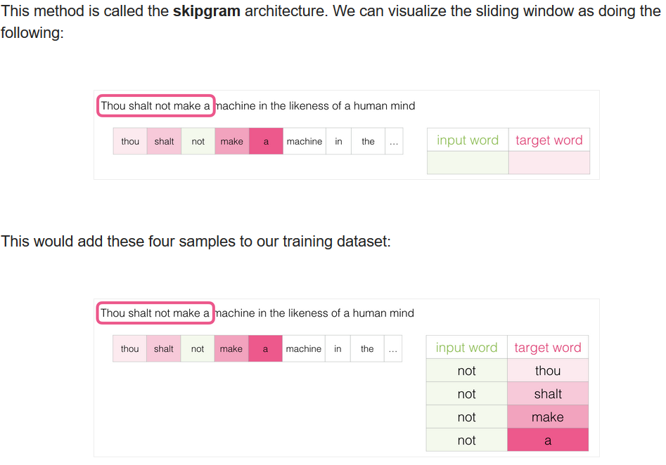

Slide 14
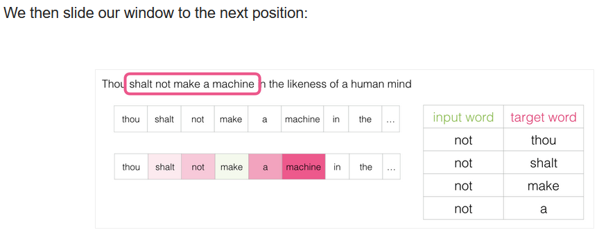

Slide 15
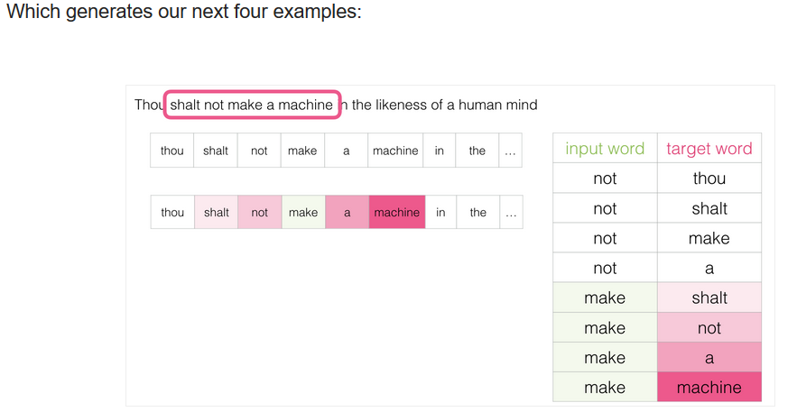

Slide 16
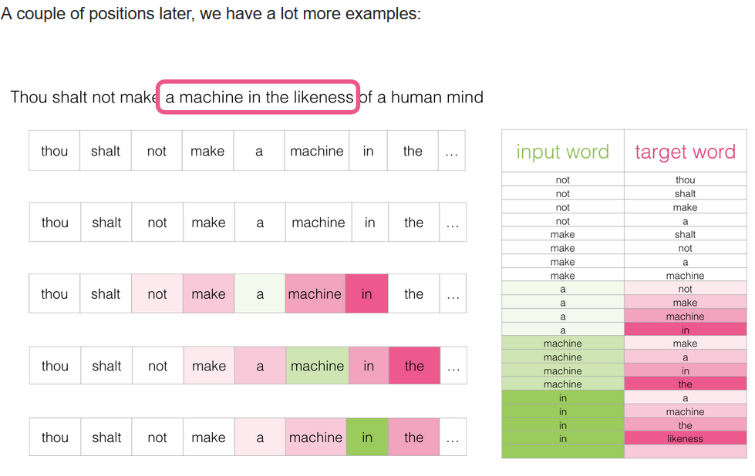

Slide 17
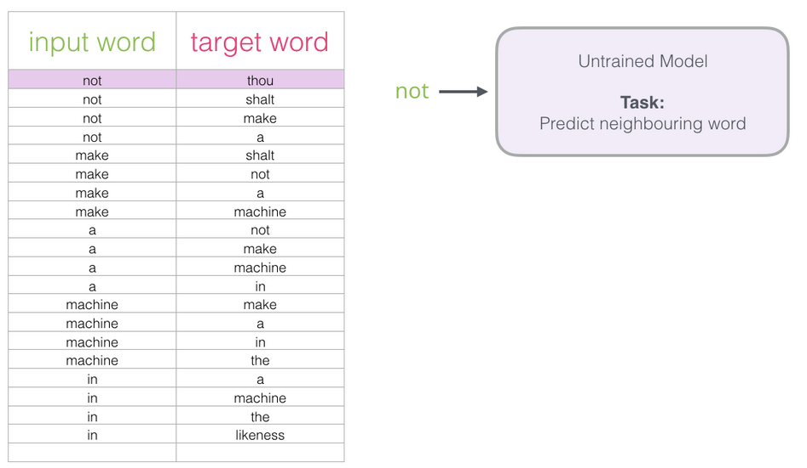

Slide 18
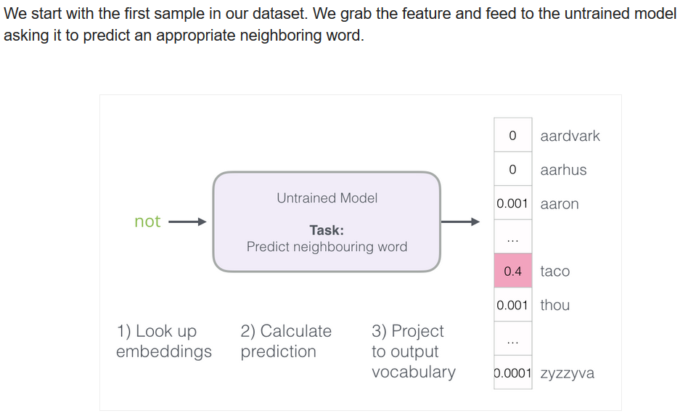

Slide 19
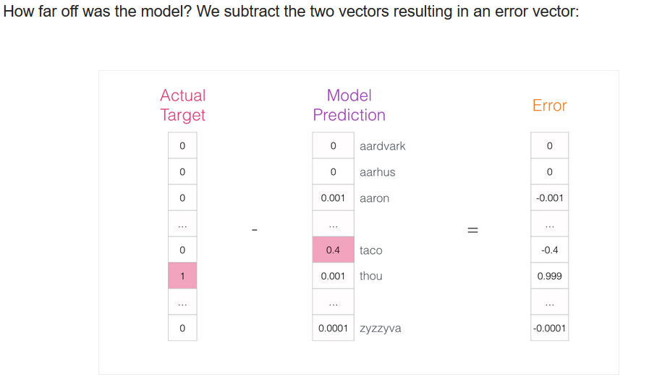

Slide 20
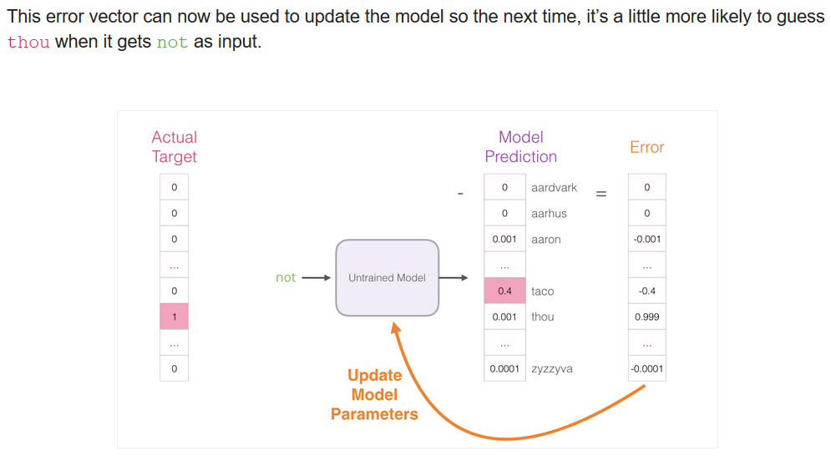

Slide 21
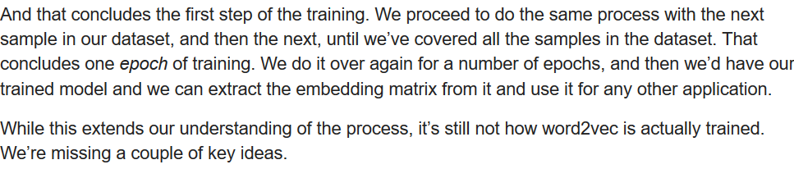
At the beginning of the training the actual input is 'not' and model should give us probability one at word 'not' but it gives 0.4 at another word and this value is the maximum probability of the all so it take the argmax.
This result is accepted at the beginning and the error will be the difference between the probability of target - prop of prediction and system will use this error to updates all weights during backpropagation.

Slide 22
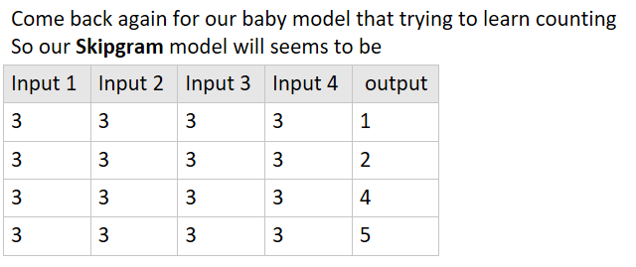

Slide 23
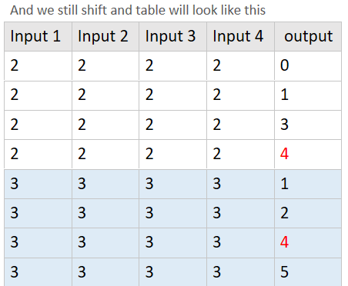
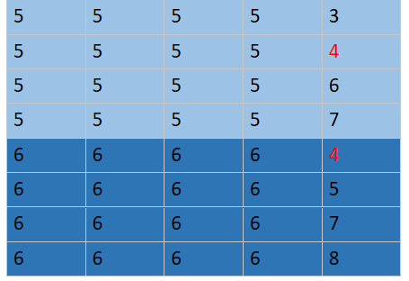
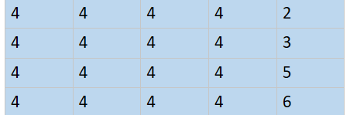
If we take the number 4 as a study case for skip gram we will see that 4 will only appeared with
Output --> input
4 -->0, 3, 5, 6
Wow, Skipgram filliped the CBOW.

Slide 24
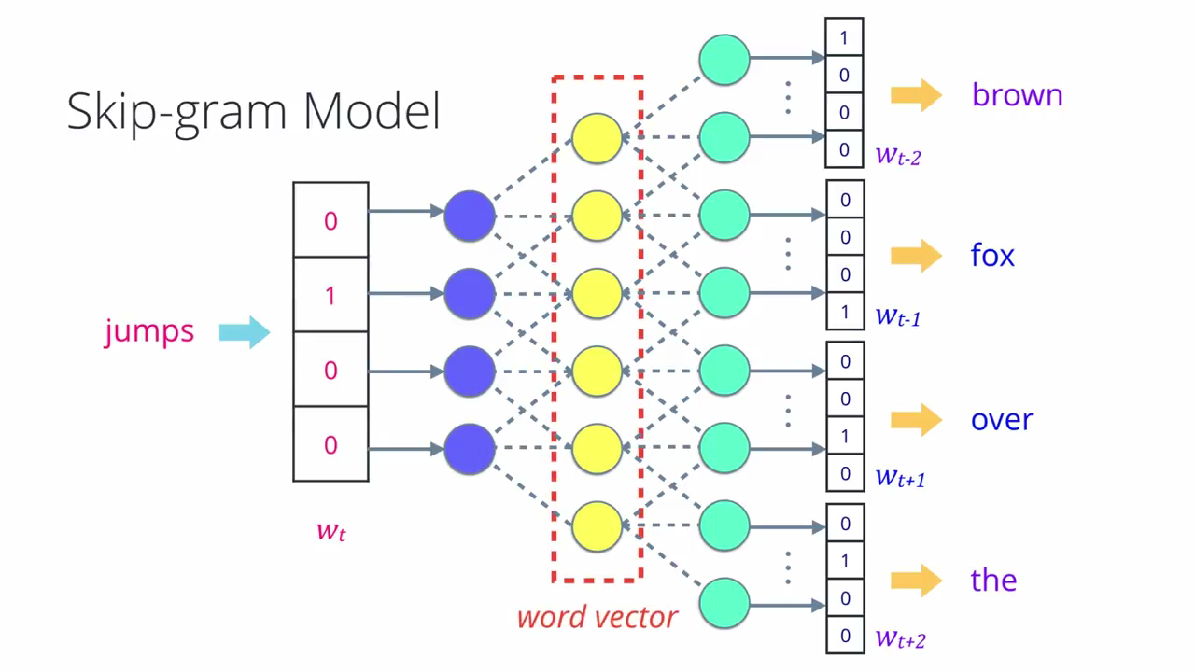

Slide 25
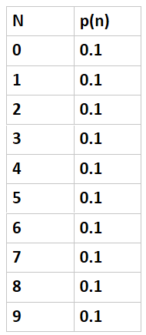
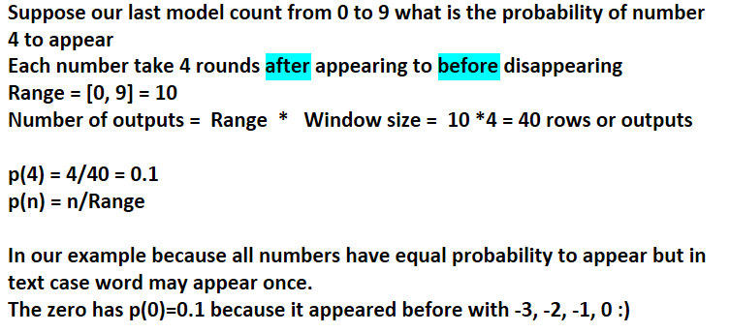
The 'target vector' is one where the target word has the probability 1, and all other words have the probability 0.
Notes:
From <https://jalammar.github.io/illustrated-word2vec/>

Slide 26
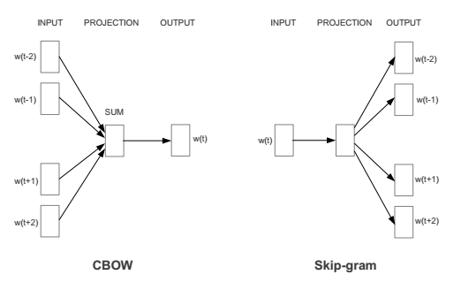

Slide 27
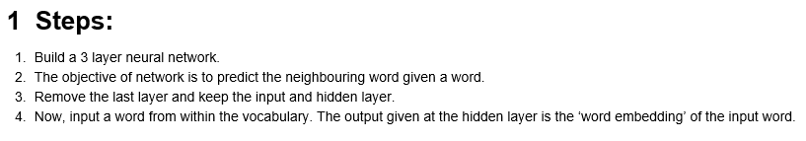
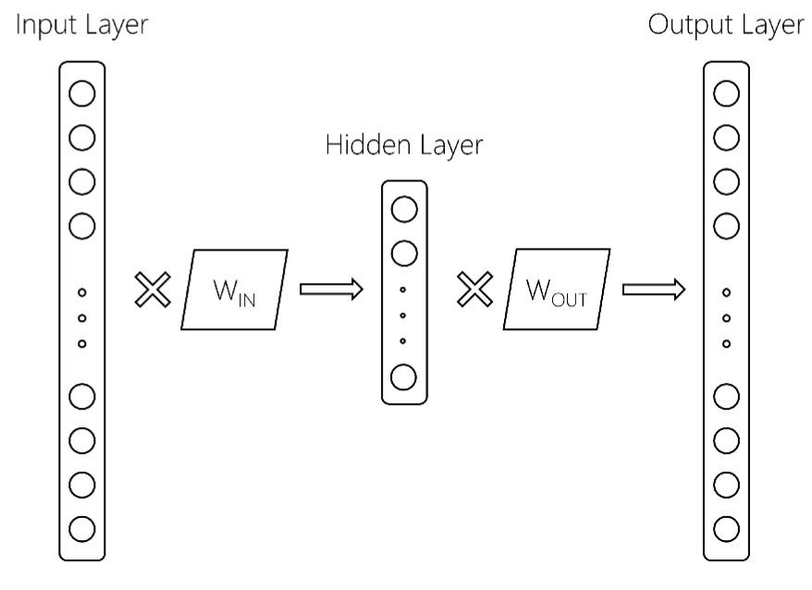

Slide 28
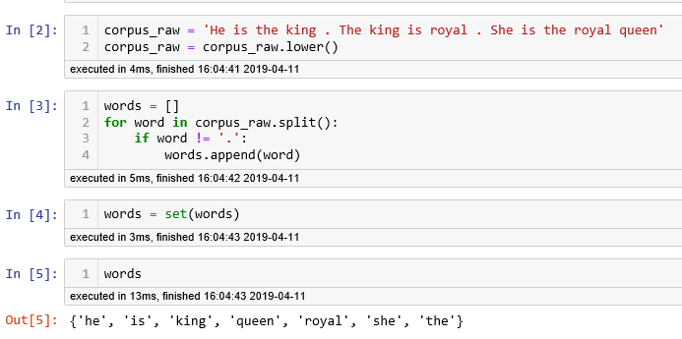

Slide 29
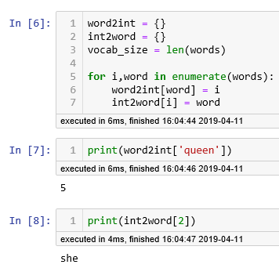
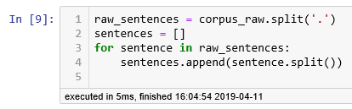
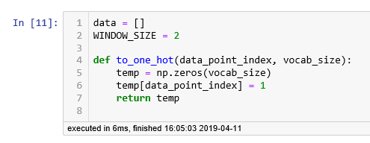

Slide 30
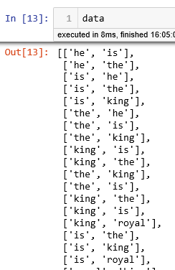

Slide 31
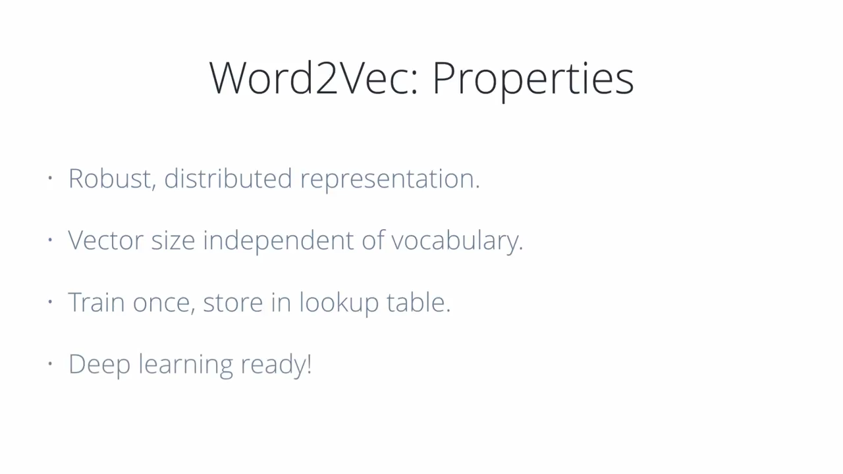

Slide 32
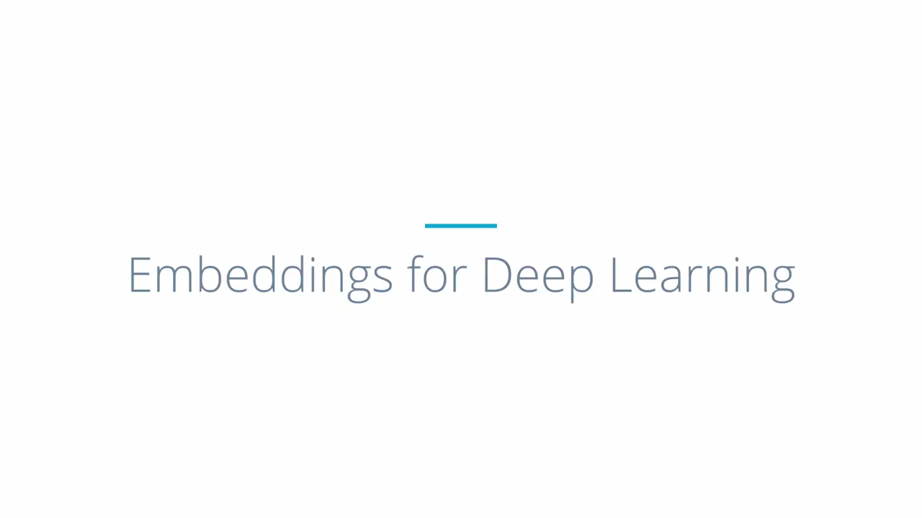

Slide 33
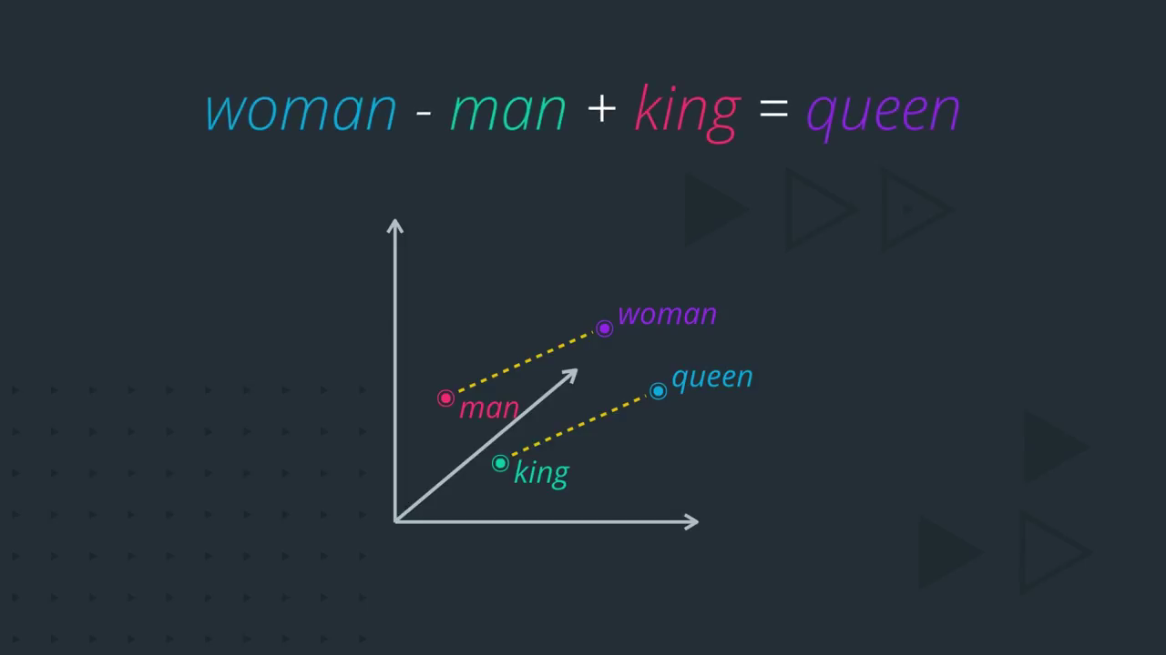

Slide 34
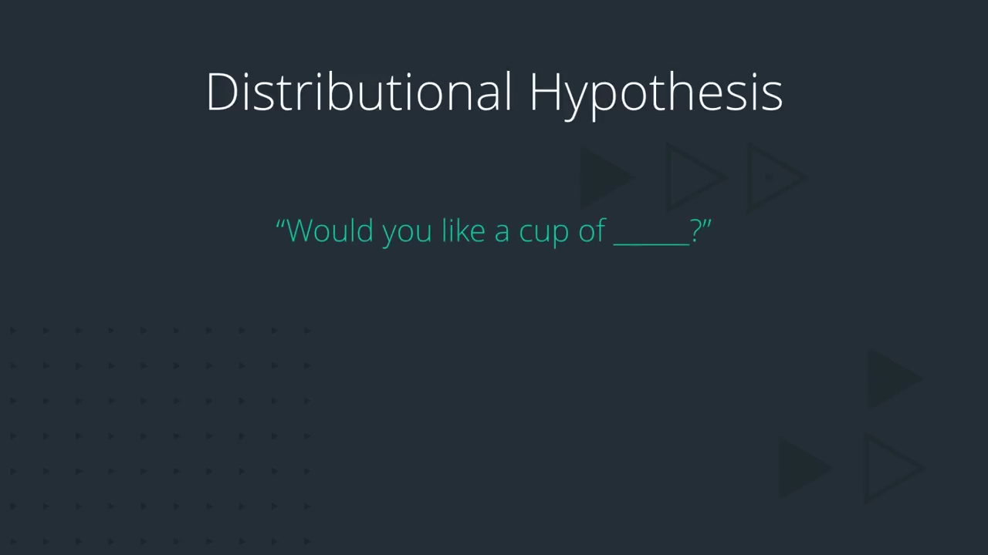

Slide 35
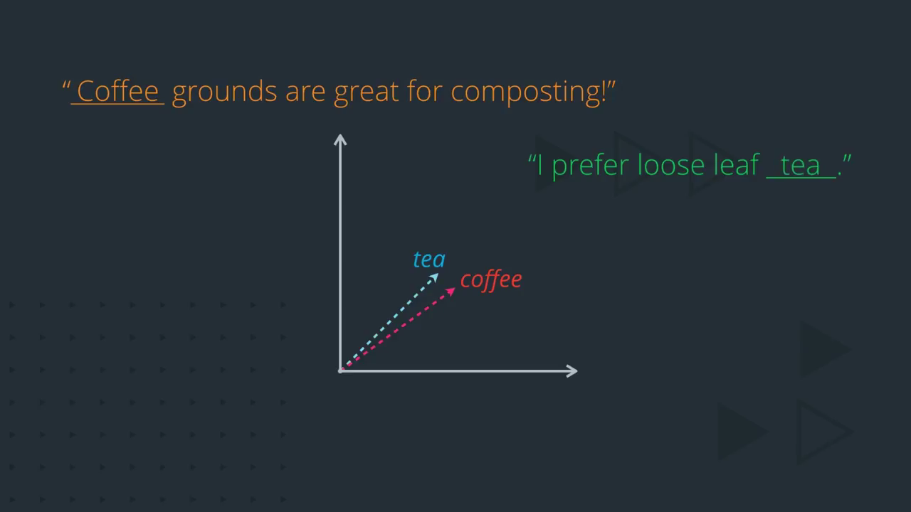

Slide 36
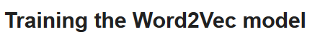
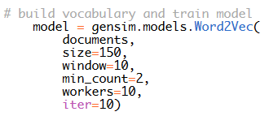
model.save("word2vec.model")
also you can continue training the model later

Slide 37
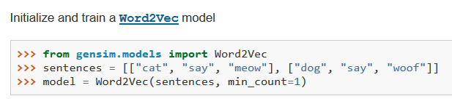
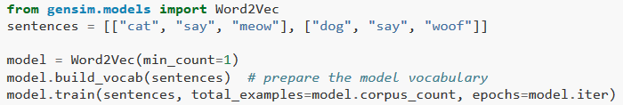

Slide 38
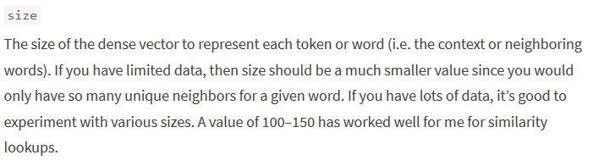
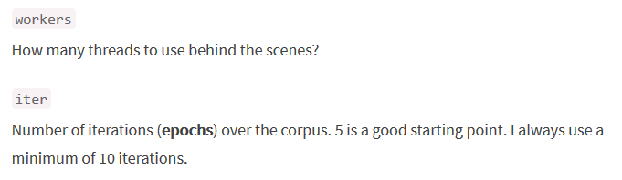

Slide 39
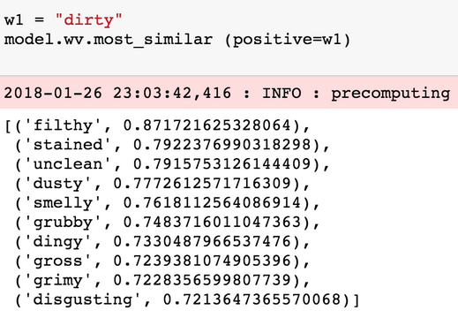

Slide 40


Slide 41


Slide 42

Keras Embedding Layer

Slide 43

keras.layers.Embedding(
input_dim, output_dim,
embeddings_initializer='uniform',
input_length=None)

Slide 44


Slide 45

Keras Embedding Layer

Slide 46


Slide 47


Keras Embedding Layer
For Transfer Learning make trainable = False and put the pretrained w2v or glove matrix weights else leave it for default (True) and don’t writhe weights.

Slide 48


Slide 49

Training using LSTM

Slide 50

Training using LSTM or GRU

Slide 51

LSTM or GRU?
The key difference between a GRU and an LSTM is that a GRU has two gates (reset and update gates) whereas an LSTM has three gates (namely input, output and forget gates), computationally more efficient (less complex structure as pointed out) so it train faster.
LSTMs should in theory remember longer sequences than GRUs and outperform them in tasks requiring modeling long-distance relations.

Slide 52


Slide 53


Passing sequence of vectors to gru
Passing hidden state to next time step
Notes:
https://towardsdatascience.com/illustrated-guide-to-lstms-and-gru-s-a-step-by-step-explanation-44e9eb85bf21

Slide 54

Bidirectional LSTM?

Slide 55

Bidirectional LSTM?
Bidirectional LSTM?
LSTM in its core, preserves information from inputs that has already passed through it using the hidden state.
Unidirectional LSTM only preserves information of the past because the only inputs it has seen are from the past.
Using bidirectional will run your inputs in two ways, one from past to future and one from future to past and what differs this approach from unidirectional is that in the LSTM that runs backwards you preserve information from the future and using the two hidden states combined you are able in any point in time to preserve information from both past and future.
What they are suited for is a very complicated question but BiLSTMs show very good results as they can understand context better

Slide 56


Bidirectional LSTM?

Slide 57

Bidirectional LSTM?

Slide 58

steps to generate sentences

Slide 59


Slide 60


Slide 61


Slide 62


Slide 63


Slide 64


Slide 65


Slide 66


Slide 67


Slide 68


Slide 69


Slide 70


Slide 71


Slide 72


Slide 73


Slide 74


Slide 75


Slide 76


Slide 77


Slide 78


Slide 79


Slide 80


Slide 81


Slide 82


Slide 83


Slide 84


Slide 85


Slide 86



Slide 87


Slide 88


Slide 89


Slide 90


Slide 91


